Slide 1
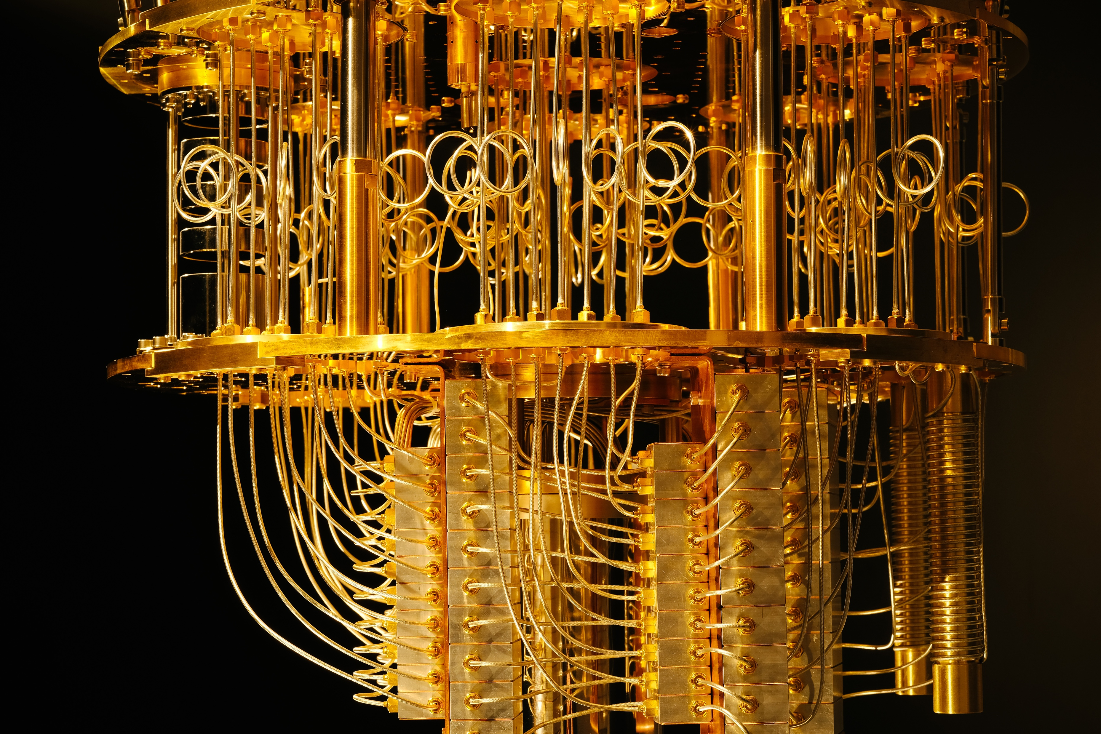


Qiskit Circuit Compilation in-depth — Luciano Bello IBM Research @microluciano @qiskit ibm.biz/qiskit-workshop quantum-computing.ibm.com research.ibm.com/ibm-q/ qiskit.org

Slide 2
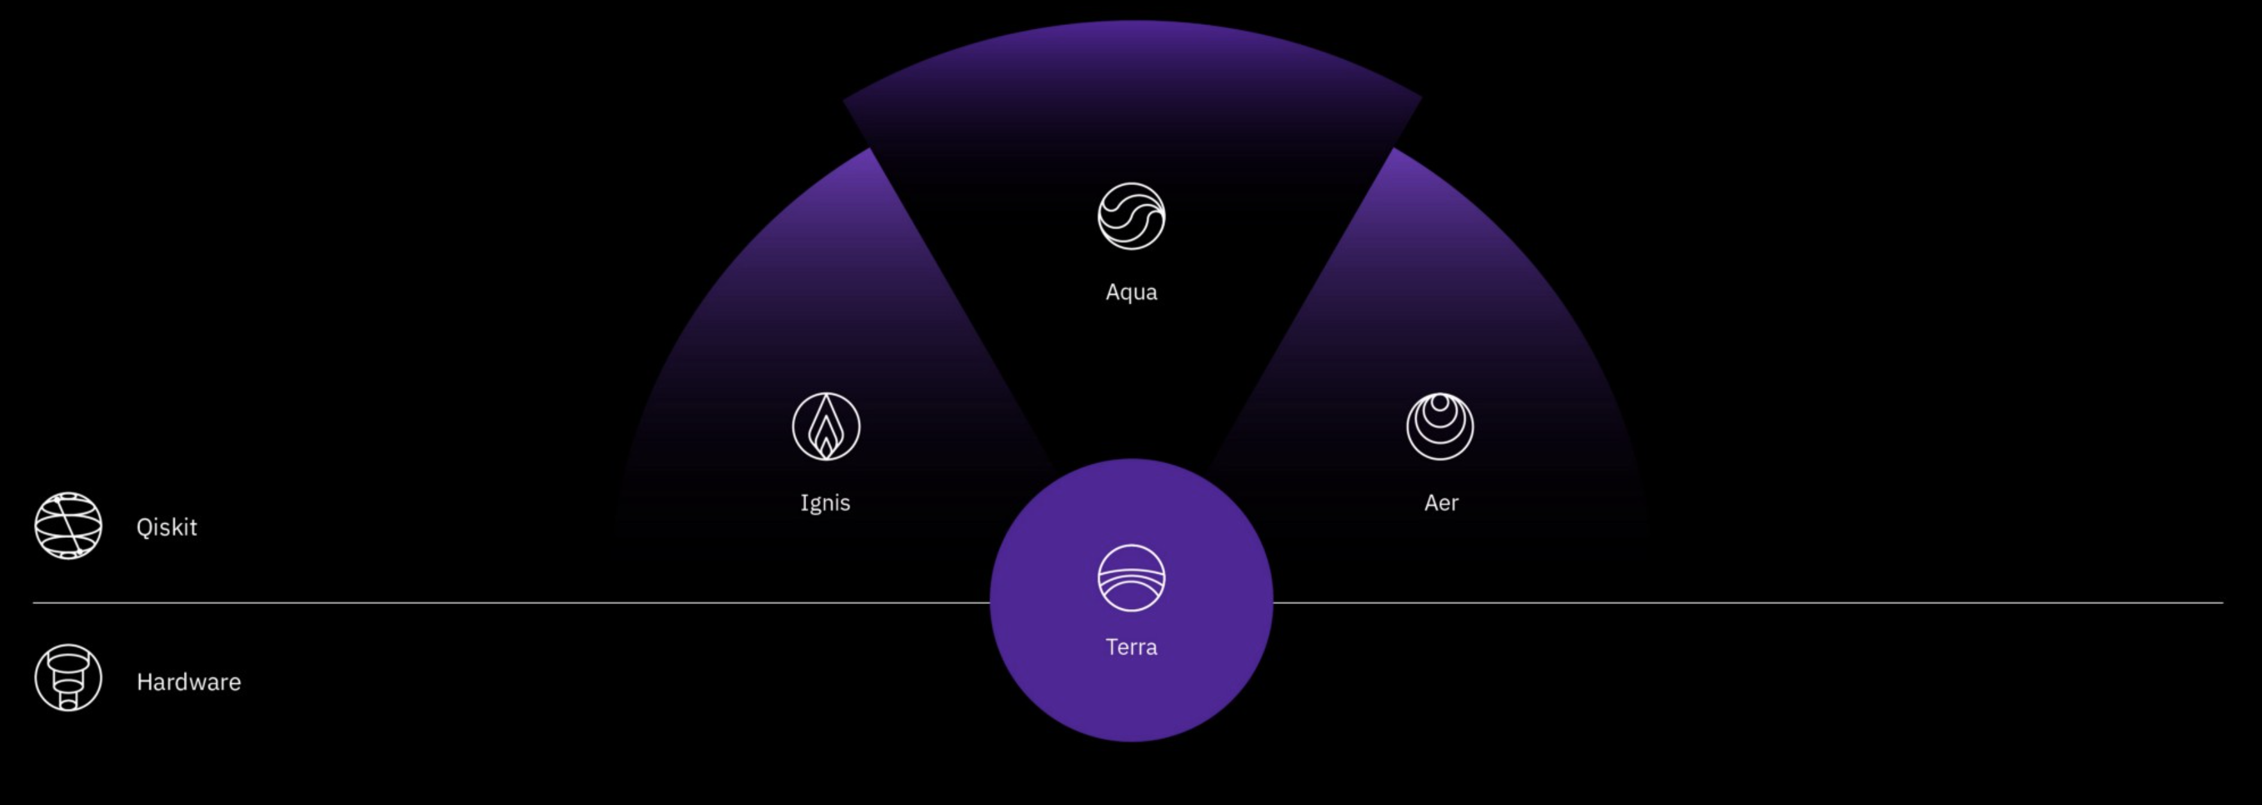
Qiskit Elements
Notes:
This presentation holds for the following versions (current stable – July 2019):
'qiskit': '0.10.4',
'qiskit-aer': '0.2.1',
'qiskit-ibmq-provider': '0.2.2',
'qiskit-terra': '0.8.2'

Slide 3
Why compiling?
Optimizations
X = 0
Y = 0
Z = input()
if (X == 1) {
Y = 5^20
} else {
Y = 20^20
}
while (X >= -1)
{ X = X - 1
Z = Z + 1
}
return(Z+X)
X = 0
Y = 0
Z = input()
Y = 20^20
while (X >= -1)
{ X = X - 1
Z = Z + 1
}
return(Z+X)
X = 0
Y = 0
Z = input()
Y = 20^20
X = X - 1
Z = Z + 1
X = X - 1
Z = Z + 1
return(Z+X)
X = 0
Z = input()
X = X - 1
Z = Z + 1
X = X - 1
Z = Z + 1
return(Z+X)
Z = input()
return(Z)
Notes:
In the classical scenario, we do optimizations all the time.

Slide 4
Why compiling?
Optimizations
Notes:
In the classical scenario, we do optimizations all the time.

Slide 5
Why compiling?
Optimizations ⟷ equivalence rules
Instruction set
push a push b add
pop c
c = a+b
load a add b store c
add a,b,c
Notes:
- 0-operand (zero-address machines) - 1-operand (one-address machines), so called accumulator machines,
- 3-operand

Slide 6
Why compiling?
Optimizations ⟷ equivalence rules
Instruction set
Notes:
Controlled Z:
- Using Hadamard (H) gate - 2-parameter 1-pulse single qubit gate
- Unitary gate

Slide 7
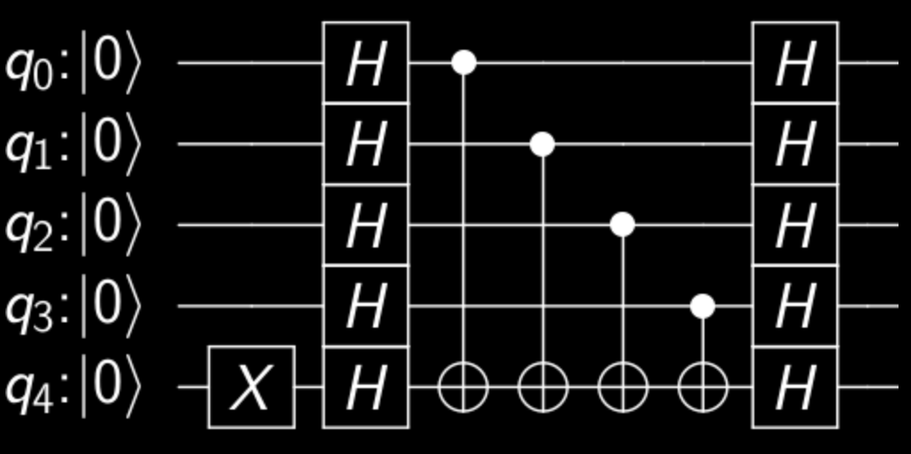
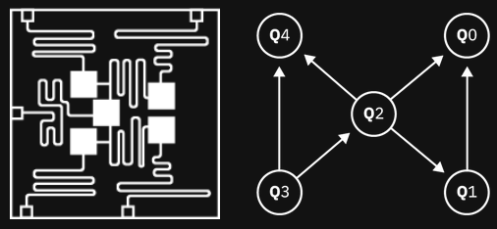
Why compiling?
Optimizations ⟷ equivalence rules
Instruction set ⟷ basis gates
Hardware limitations
Notes:
In the classical scenario, we do optimizations all the time.

Slide 8
Why compiling?
The Mapping
Problem
Optimizations ⟷ equivalence rules
Instruction set ⟷ basis gates
Hardware limitations

Slide 9
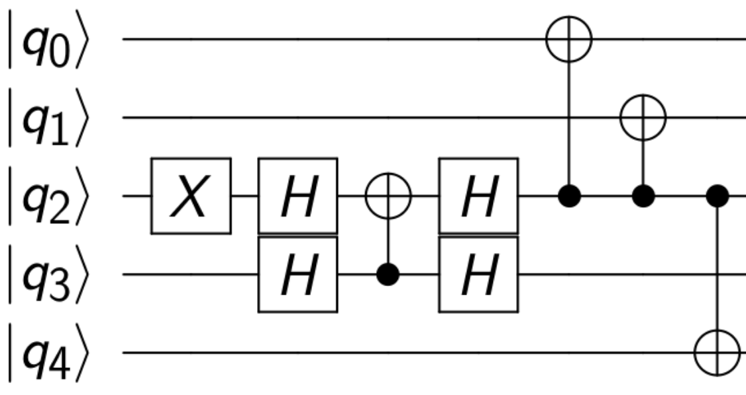
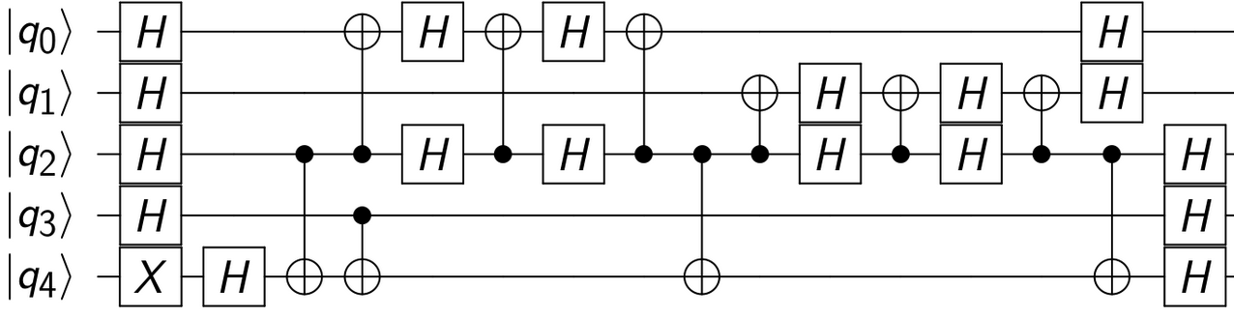

Slide 10
Notes:
1. Limited qubits, plenty of noise: make the circuit as small as possible, under tight constraints

Slide 11
Noise everywhere!
Gate error
Single qubit gate
Multiple qubit gates
Readout error
Decoherence time
1
1
T1
T2
½
time
time
Notes:
From: Lecture 19: How to Build Your Own Quantum Computer, by Isaac Chuang and Fen Zhao , November 13, 2003
T1 is called the “longitudinal coherence time,” or the “spin lattice time,” or the “spontaneous emission time,” or the “amplitude damping.” It measures the loss of energy from the system.[...]
T2 is called the “transverse coherence time,” or the “spin­spin relaxation time,” or the “phase coherence time,” or the “elastic scattering time,” or the “phase damping.”

Slide 12
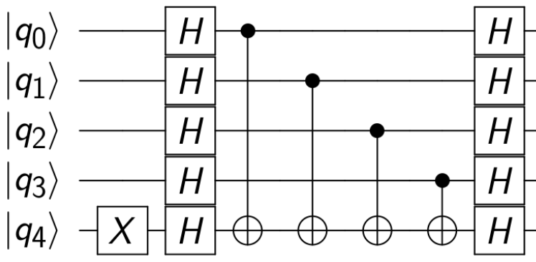
Property Set
Pass 1
Pass 2
Pass 3
Unroll to basis
Cancel redundant gates
Map to device by swapping
Pass 4
Cancel redundant gates
Depth
Commuting Sets
Pass Manager
Layout
Fixed Point Condition
Notes:
Each pass does one small, well-defined task.
The complexity of scheduling is solely in the pass manager, to keep passes simple
The pass manager maintains a global context (the property set) about the circuit as it runs through the pipeline

Slide 13
Relationship between Pass Objects
BasePass
Analysis Pass
Transformation Pass
- Read-only Access to Circuit
- Write Access to Property Set
- Write Access to Circuit
- Read-only Access to Property Set
requires
preserves
Notes:
Example (commutation relationships):
Pass A is an Analysis Pass that inspects the graph and finds nodes that can commute.
Pass B is a Transformation Pass that dissolves those edges that commute (are false dependencies).
Pass B requires Pass A, and indicates this to the Pass Manager

Slide 14
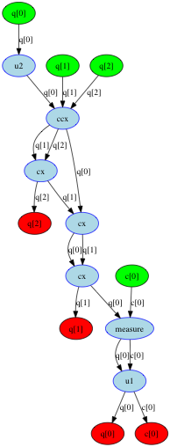
DAG
Directed Acyclic Graph
Notes:
The circuit is internally represented as a Directed Acyclic Graph (DAG)
Dataflow and dependencies are explicit, so easier to manipulate
Green: Input nodes
Red: Output nodes
Blue: Operations

Slide 15
execute
transpile
circuit
PassManager.run
circuit_to_dag
run passes on dag
dag_to_circuit
circuit
assemble
Qobj
backend.run
result
Notes:
This is true at Qiskit-terra 8.0

Slide 16
- Why do we need compilation? Optimization Adapt to the basis Hardware limitations (mapping to the coupling map) - Noise and errors The price of bad optimizations Types of error - Qiskit-Terra compilation internals Transpiler: Passes, PassManager, and property set Internal DAG representation The execution pipeline
Summary so far

Slide 17
☆☆☆☆★ Write your own pass manager ☆☆☆★★ Does it (sometimes) works better than preset ones? In terms of depth or amount of CXs ☆☆☆★★ Improve an existent preset pass manager Avoid a pass repetition, an unnecessary pass, etc. ☆★★★★ Improve an existent pass ★★★★★ A new/better pass Bonus! ☆☆☆☆★ Find a non-duplicated bug and submit it! ☆☆☆★★ Fix the bug with a PR

Slide 18

THANK YOU
THANK YOU

